Slide 1
Alex 1.6
Overview
IDR Team Training
Wes McFee, Principal Scientist – AI/ML & Scott Rader, Director of Digital Health

Slide 2
Alex 1.6
What is it?
Alex 1.6 is a custom-built AI assistant built in Copilot by IPRO’s AI team.
Designed to support IDR rules and workflows.
Alex was trained on key reference documentation from CMS.
Role-aware support: it tailors answers for Claims Specialists, Nurse Arbitrators, and Supervisors if you tell it what your role is.
By design, Alex 1.6 never predicts outcomes or gives legal advice.

Slide 3
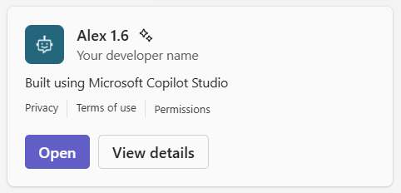
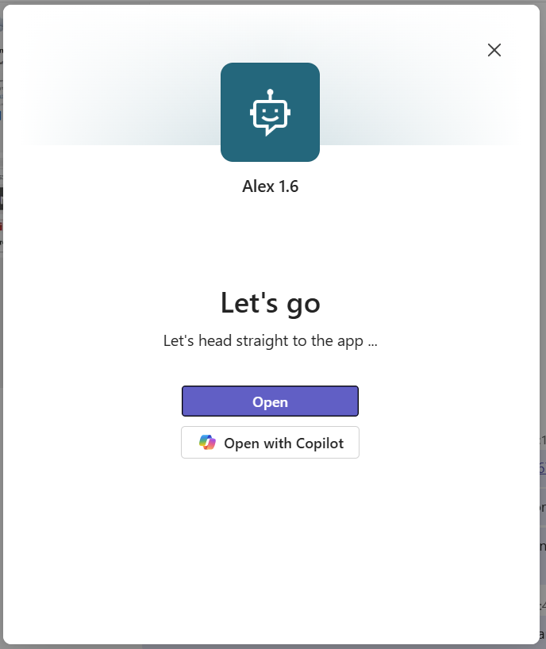
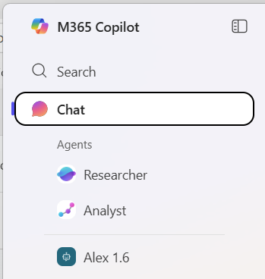
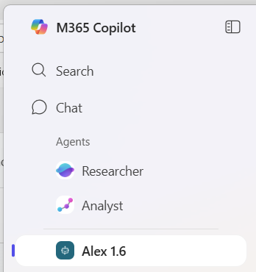
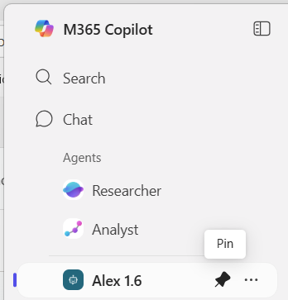
Accessing Alex

Slide 4
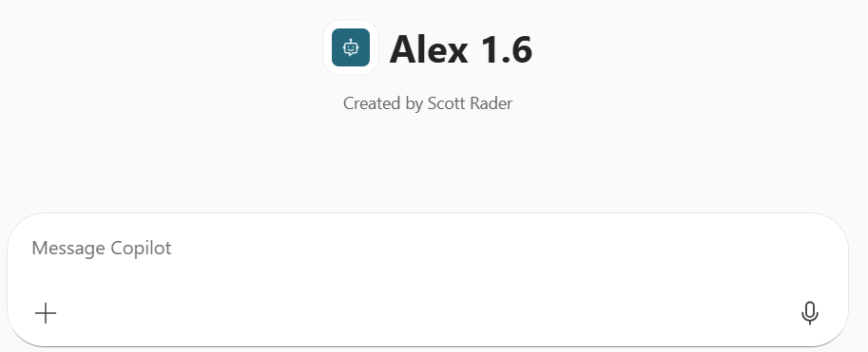
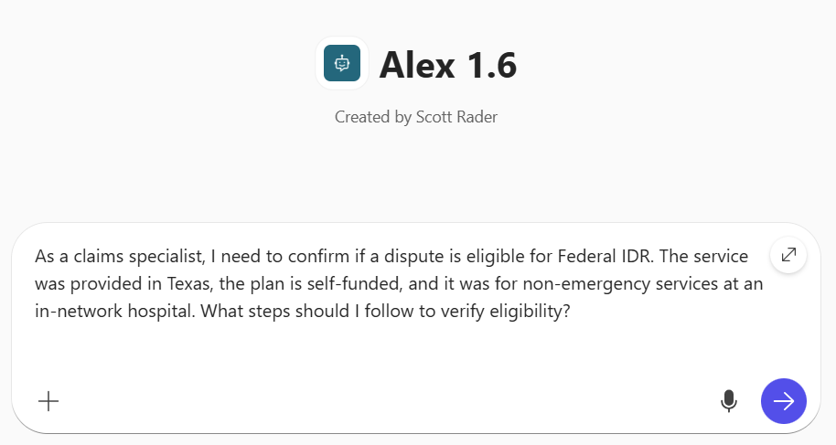
Using Alex

Slide 5
Responses from Alex
What if it doesn’t tell me what I’m looking for?
Provide more context and/or information. Treat it like you’re texting a human who hasn’t given you the level of detail that you’re seeking.
As a rule, general questions receive general answers. Specific questions receive specific answers.
If Alex is ultimately not helping with a specific line of questioning and you’ve tried multiple questions, contact your supervisor for assistance.

Slide 6
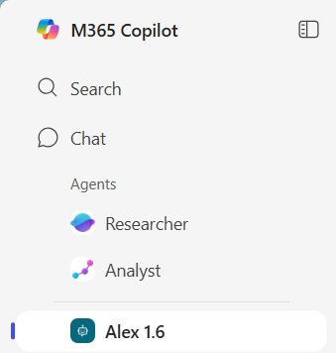

Other Features
Unlike ChatGPT, dictation with Copilot is only one-way. Meaning, you can communicate with voice to Copilot, but Copilot does not respond to you using voice.

Slide 7
Questions?
Wes McFee, Principal Scientist – AI/ML
Scott Rader, Director of Digital Health

